Slide 1
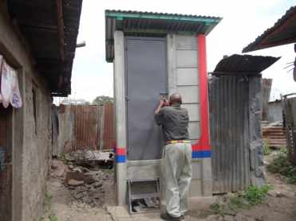
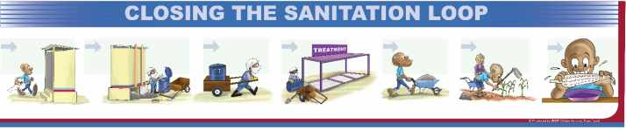
Water Sector Trust Fund
Sanitation marketers Training
What is sanitation?
The Sanitation Value Chain
Sanitation in urban Kenya
Main sanitation challenges

Slide 2
What is sanitation?
  For many organisations, hygiene promotion is seen as an integral part of sanitation. The Water Supply and Sanitation Collaborative Council defines sanitation as:
  "The collection, transport, treatment and disposal or reuse of human excreta, domestic wastewater and solid waste, and associated hygiene promotion.”
  _____________________________________
  The Water Supply and Sanitation Collaborative Council (WSSCC) is a global membership organization hosted by the United Nations that specialises in sanitation and hygiene for poor people in countries with severe sanitation and hygiene needs
  (Quote from Wikipedia, keyword: sanitation)

Slide 3
What is sanitation?
The term "sanitation" is applied to a wide range of subjects such as:
Improved sanitation - refers to the management of human faeces at the household level. This terminology is the indicator used to describe the target of the Millennium Development Goal on sanitation
On-site sanitation - the collection and treatment of waste is done where it is deposited. Examples are the use of pit latrines and septic tanks
Environmental sanitation - the control of environmental factors that form links in disease transmission. Subsets of this category are solid waste management, water and wastewater treatment, industrial waste treatment and noise and pollution control
Ecological sanitation - an approach that tries to emulate nature through the recycling of nutrients and water from human and animal wastes in a hygienically safe manner

Slide 4
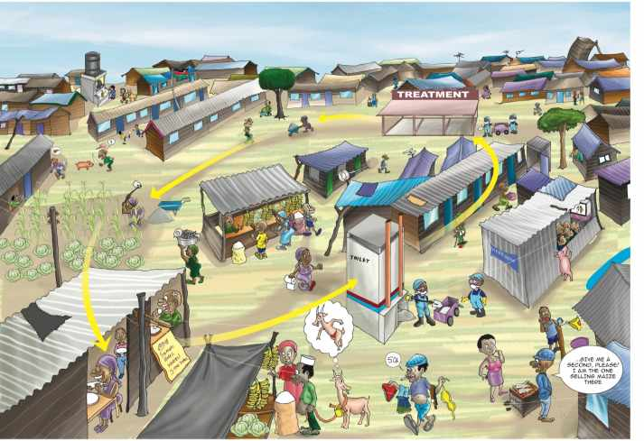
The Sanitation Value Chain
What is the sanitation (value) chain according to you?...............

Slide 5
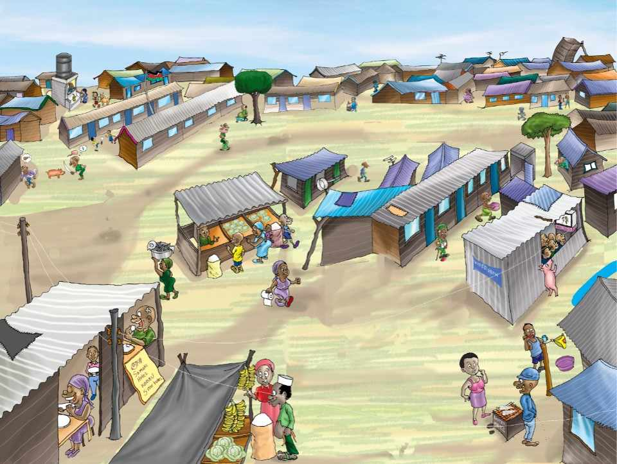





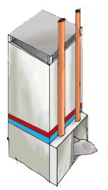

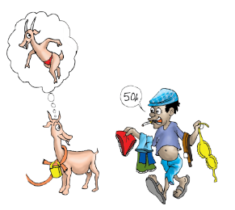
Toilets, transport & treatment
for improved health & hygiene
for a better, cleaner environment
and business opportunities
Presentation Outline

Slide 6
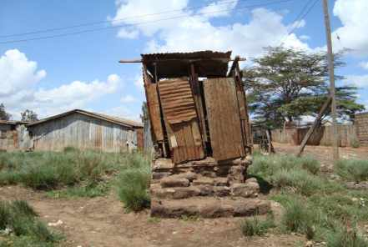
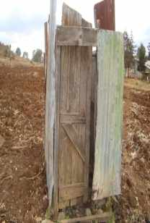
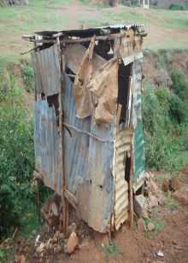
Sanitation Situation in Kenya
Sanitation access nationally according to the WHO/UNICEF – JMP for Water Supply and Sanitation(2010)
Overall access = +- 31%
47% of the urban low income area population use an improved toilet
28% of urban households in low income areas share an improved toilet
8% of urban households in low income areas have an improved toilet
20% of all urban households have access to a sewer

Slide 7
Sanitation situation in urban Kenya
Urban sanitation coverage figures
No. | Facility | % use
1. | Traditional Pit Latrine | 42.17
2. | Improved Pit Latrine | 18.37
3. | Pour Flush Toilets | 12.43
4. | Toilet Linked to Septic Tank | 7.80
5. | Toilet Linked to Sewer | 6.94
6. | Public (Fee Paying) Facility | 4.04
7. | Other Sanitation Facility | 3.85
8. | Ventilated Improve Pit Latrine | 2.29
9. | Open defecation (OD) | 1.53
10. | Flying Toilets | 0.39
11. | Others (Biogas, UDT, Open Discharge | 0.18
Sanitation facilities and practice used in Kenya’s urban low income areas (Source: MajiData)

Slide 8
Sanitation challenges
Some of the main sanitation challenges are:
Toilets & water:
Low access to sanitation at the household/plot levels
Lack of water to improve hygiene
____________________________
Infrastructure:
Limited network of sewer systems (settlement & town level)
Few Water Service Providers with functioning wastewater treatment plants
____________________________
Policy:
Poor designs of affordable & sustainable sanitation solutions for the poor
Poor sanitation monitoring & tracking for reporting
Over-expectation that waterborne solutions will be implemented in urban low income areas
Non-prioritisation of urban low income areas by the Sector

Slide 9
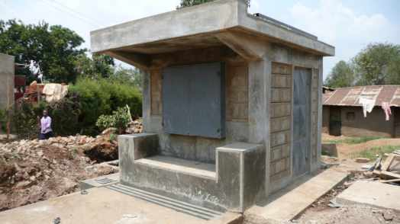

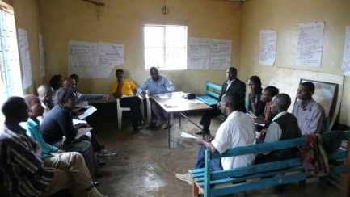
Thank You
Let us succeed together!

